Slide 1
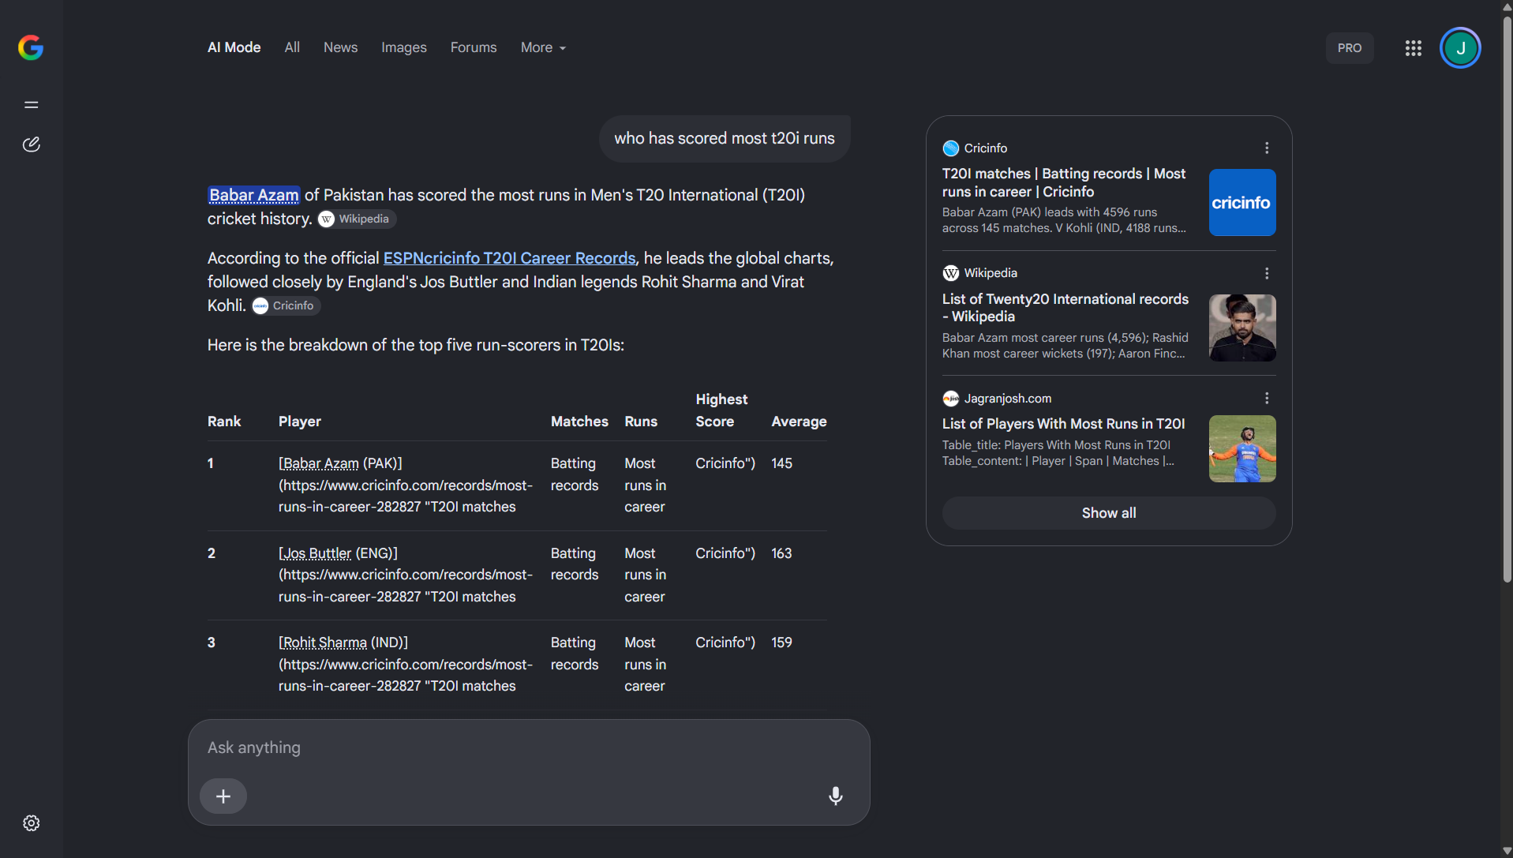
Make AI Know Her
AI can make women’s cricket invisible
GOOGLE AI MODE: MAGNIFIED QUESTION AND OPENING ANSWER
A neutral cricket question receives
an answer about men’s records.
Women lose visibility when fans
do not know to ask about them.
Individual example. Enlarged excerpt from the original Google AI Mode screenshot.
GitHub repository
Architecture diagram
Code overview
github.com/Joannapreethi28/ICC-26
gitdiagram.com/joannapreethi28/icc-26
gitingest.com/joannapreethi28/icc-26
01

Slide 2
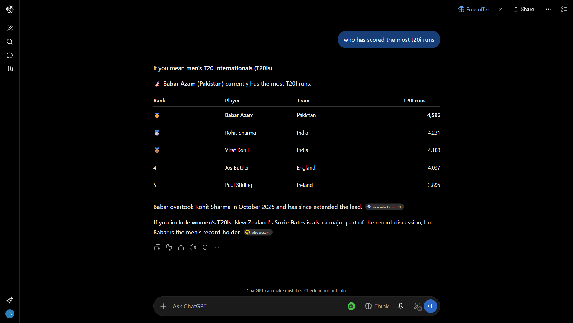
Gender fairness through sourced answers
ChatGPT mentions women, but gives no women’s total or current leader.
CHATGPT: MAGNIFIED ANSWER EXCERPT
Our sourced answer
WOMEN’S T20Is
MEN’S T20Is
Smriti Mandhana
Babar Azam
4,867 runs
4,596 runs
As of 22 Sep 2026
As of 1 Oct 2026
Dated record snapshots. Sources: project record database (linked).
02

Slide 3

Technical feasibility
& ease of integration
Laya
Trained multilingual AI
322M
Laya interprets the question, supported by rules.
Explainable policy and verified data
parameters
Neutral, supported questions receive both.
The database supplies sourced, dated facts.
Open model.
CPU inference.
MCP server + REST API
Connect compatible assistants.
No retraining of the host model.
English, Hindi and Tamil
Local integration. Coverage and language validation remain limited.
03

Slide 4
Impact on Women in Sport
Women’s Visibility Rate: answers containing a women’s record
+41.8 percentage points
versus the plain model. View experiment and results.
Llama 3.1 8B. 106 neutral English questions.
Three responses per question per condition.
Preliminary automatic labels. Human review pending.
Visibility measures inclusion, not factual accuracy.
04

Slide 5
Sustainable, inclusive adoption
Value to fans & athletes
Affordability & accessibility
Women’s achievements appear
in everyday cricket discovery.
Open Laya model
Cross-sport potential
CPU inference
Future: football, tennis and athletics.
Reuse MCP to surface women’s records.
Add verified data and test each sport.
No paid API calls
for our layer
Visibility need: UNESCO
IOC guidance
Proposed ICC pilot
Hosting costs depend on usage.
Measure visibility, correctness,
coverage and cost per query.
Presented by
Joanna Preethi (Team Lead)
Jabin Joseph
Efanio Jens
05

